Slide 1
>> IN THE NAME OF ALLAH, THE MOST GRACIOUS, THE MOST MERCIFUL <<
NONLINEAR DYNAMIC ANALYSIS UNDER A SINGLE GROUND MOTION RECORD COMPUTATION AND VISUALIZATION RESPONSE SPECTRA OF ACCELERAION, VELOCITY, DISPLACEMENT DUCTILITY DAMAGE INDEX USING OPENSEES
(CONSTANT STRUCTURAL DUCTILITY RATIO RESPONSE SPECTRUM)
WRITTEN BY SALAR DELAVAR GHASHGHAEI (QASHQAI)

Slide 2
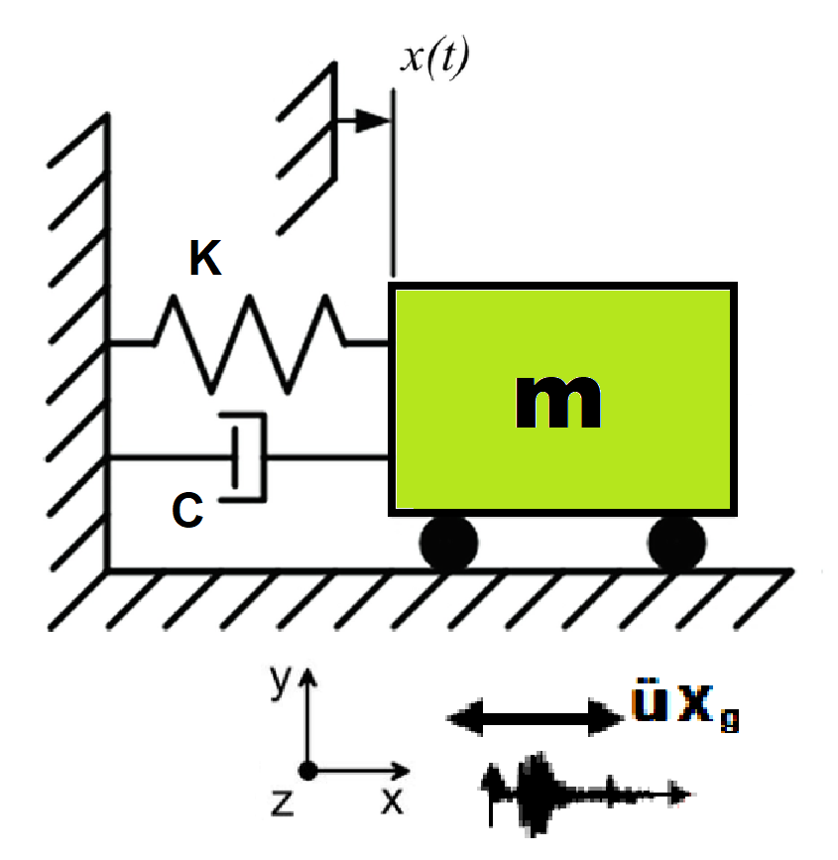
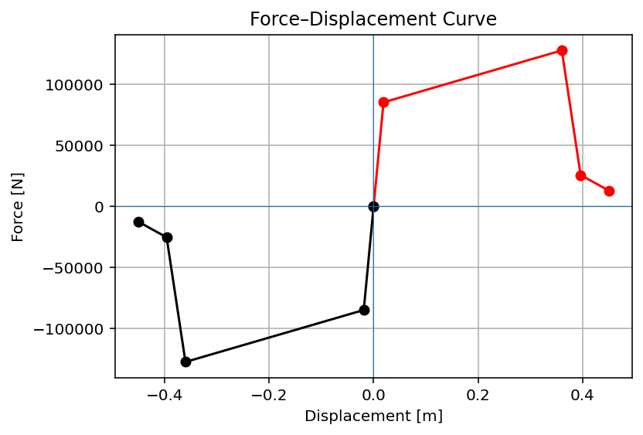

Slide 3
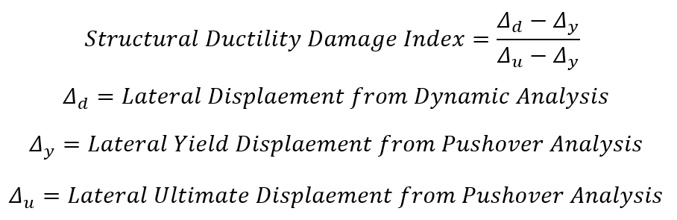

Slide 4
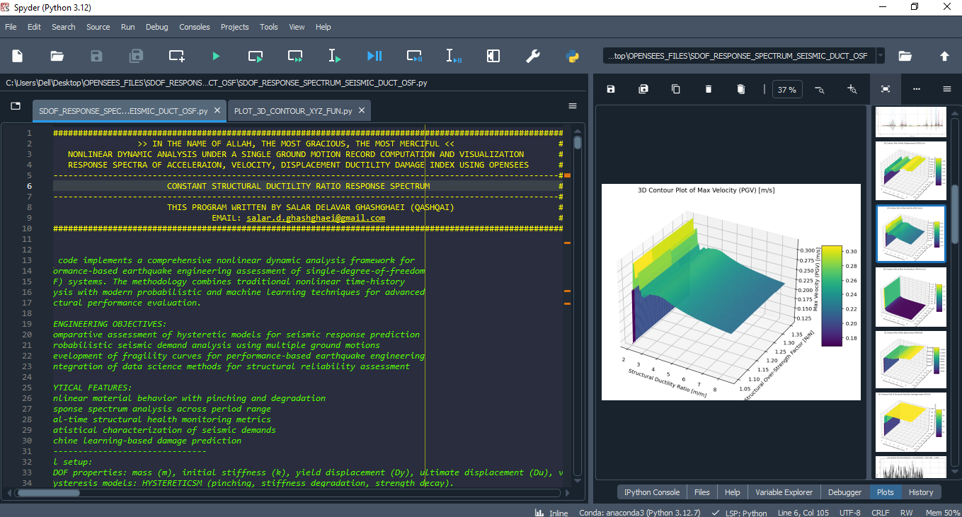

Slide 5
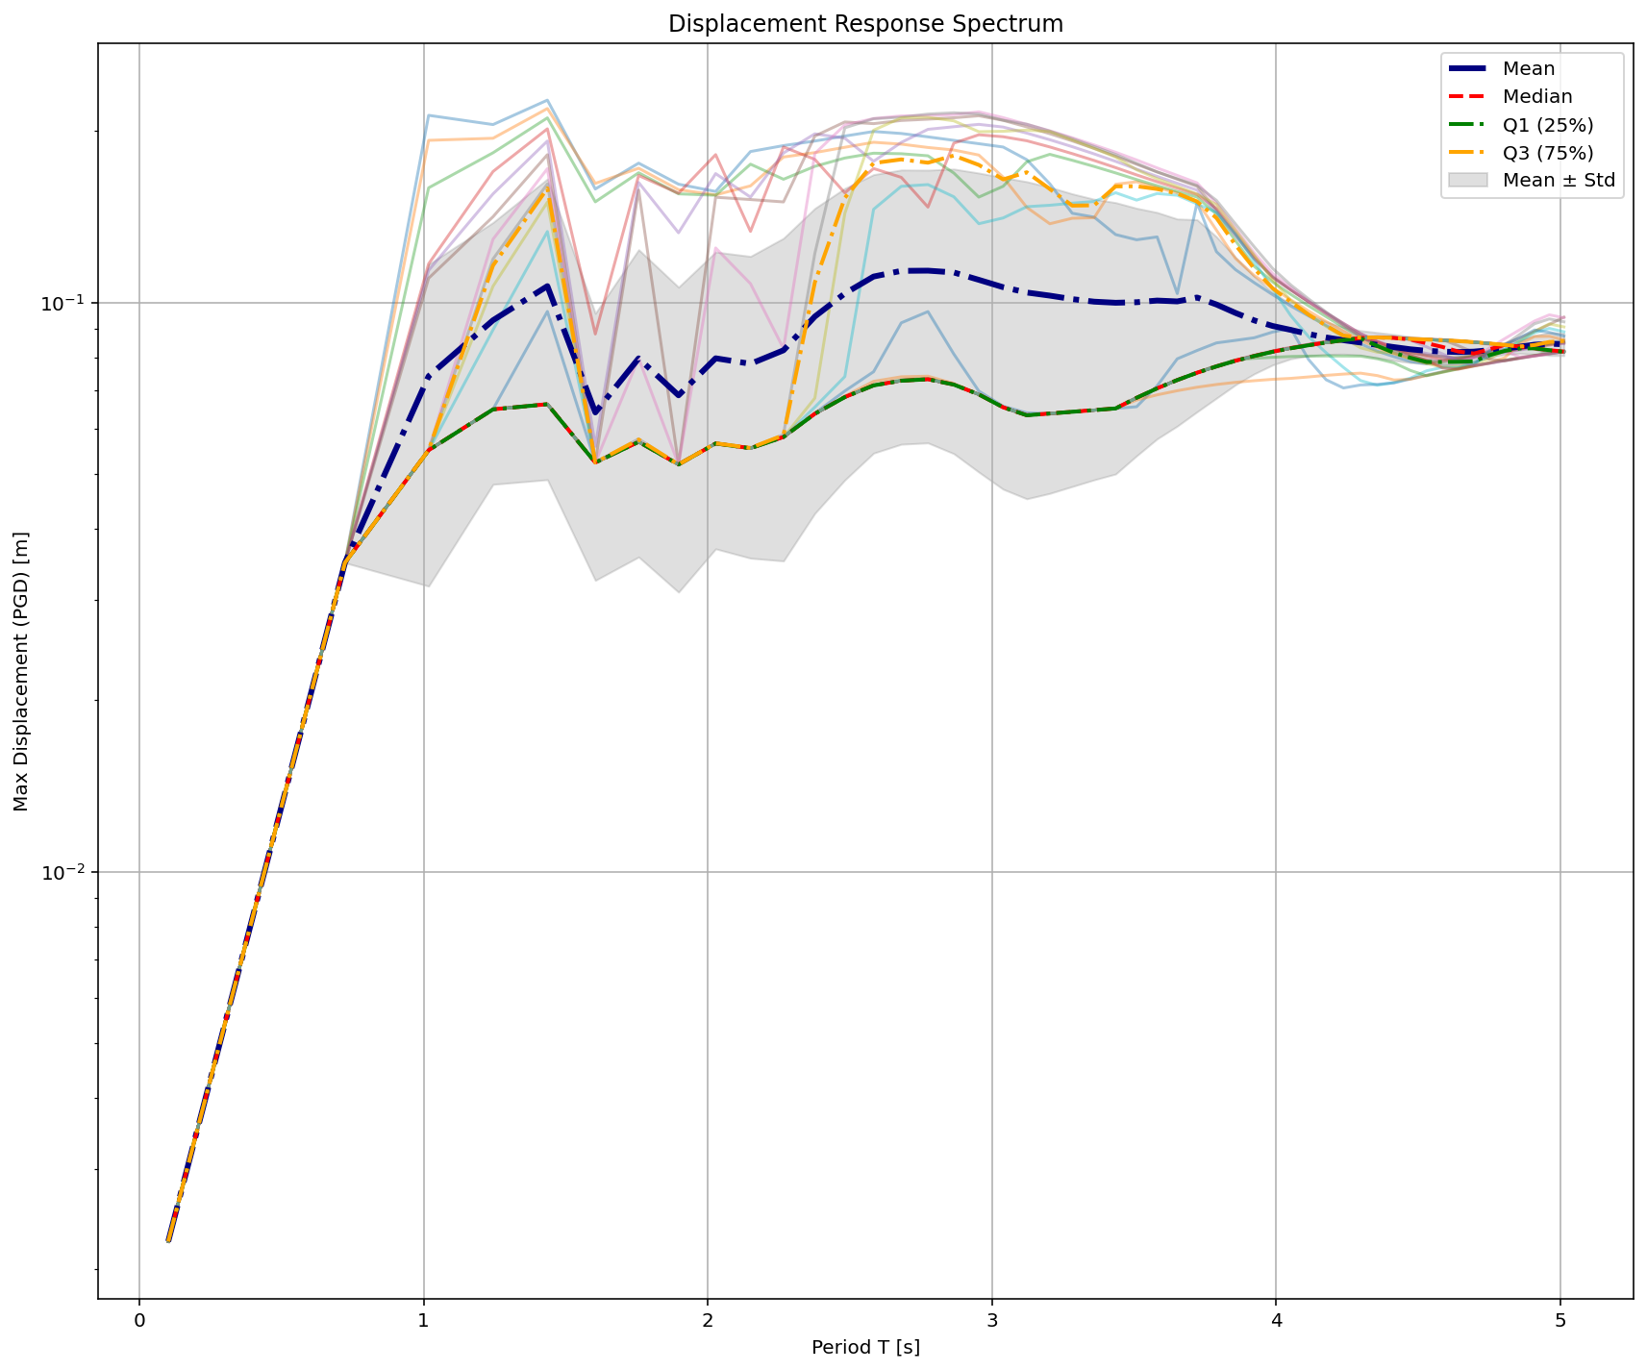

Slide 6
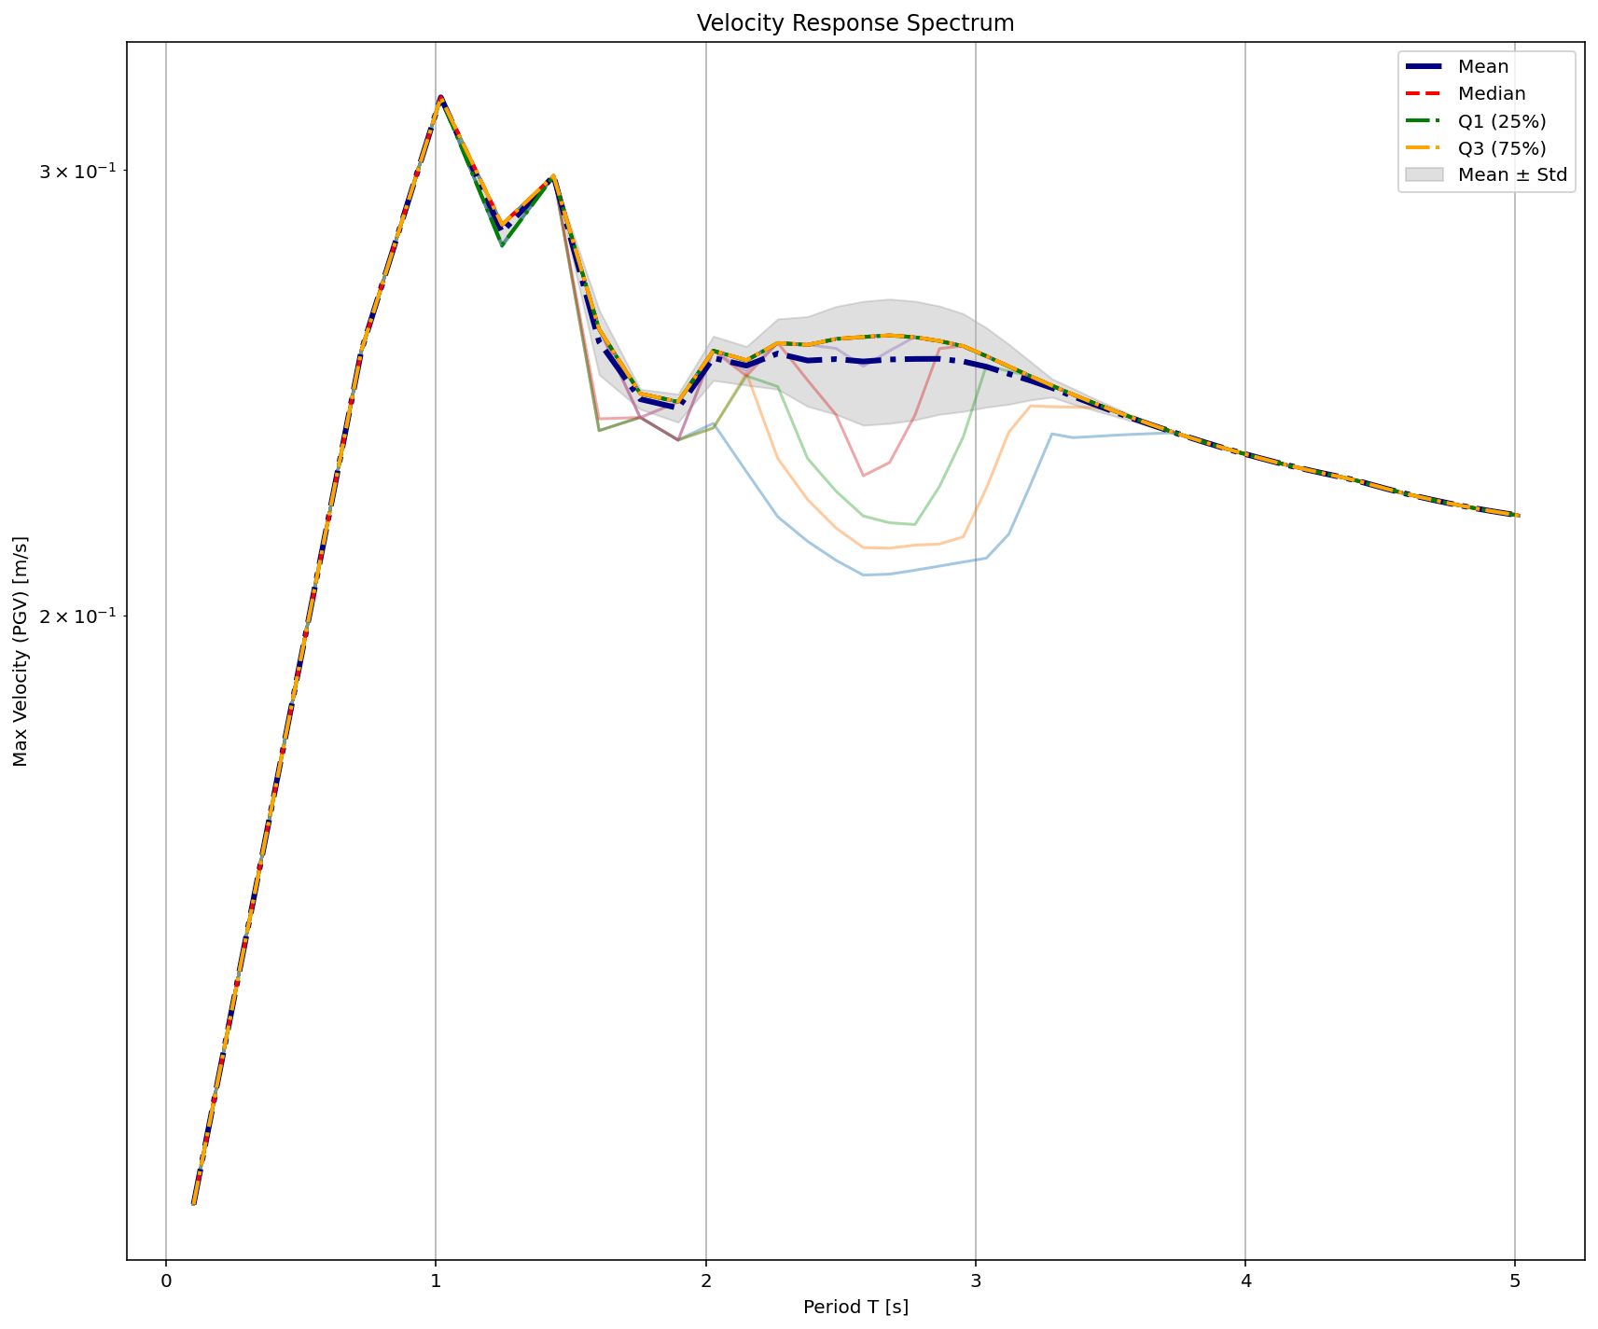

Slide 7
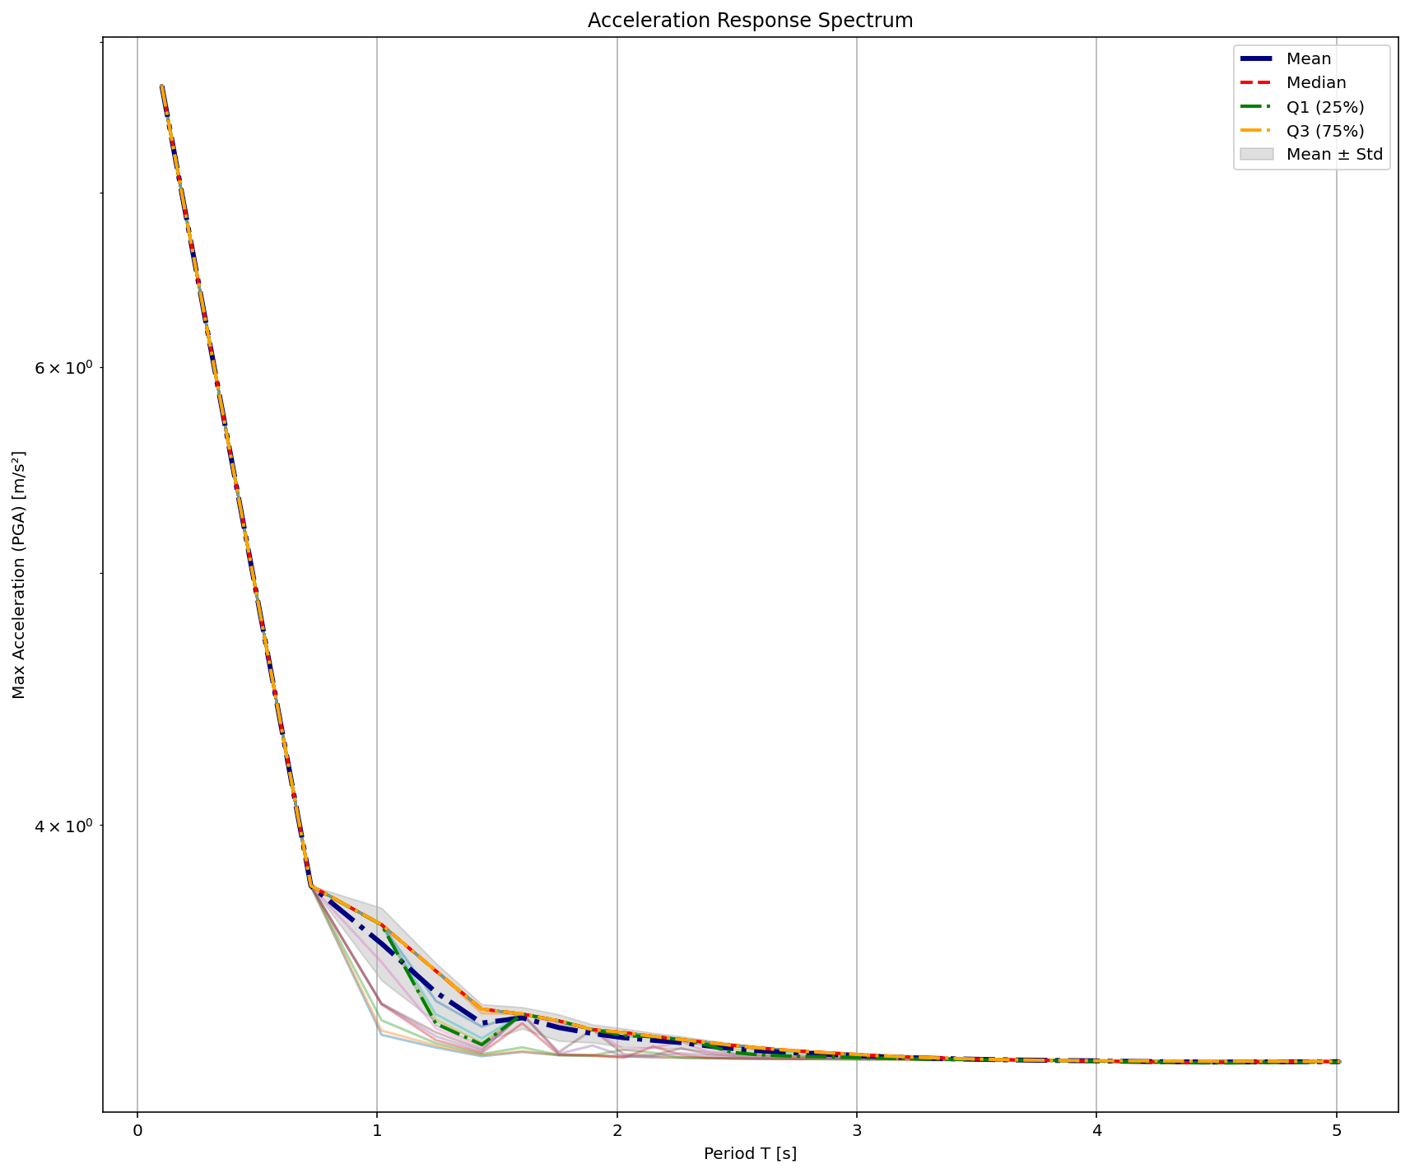

Slide 8
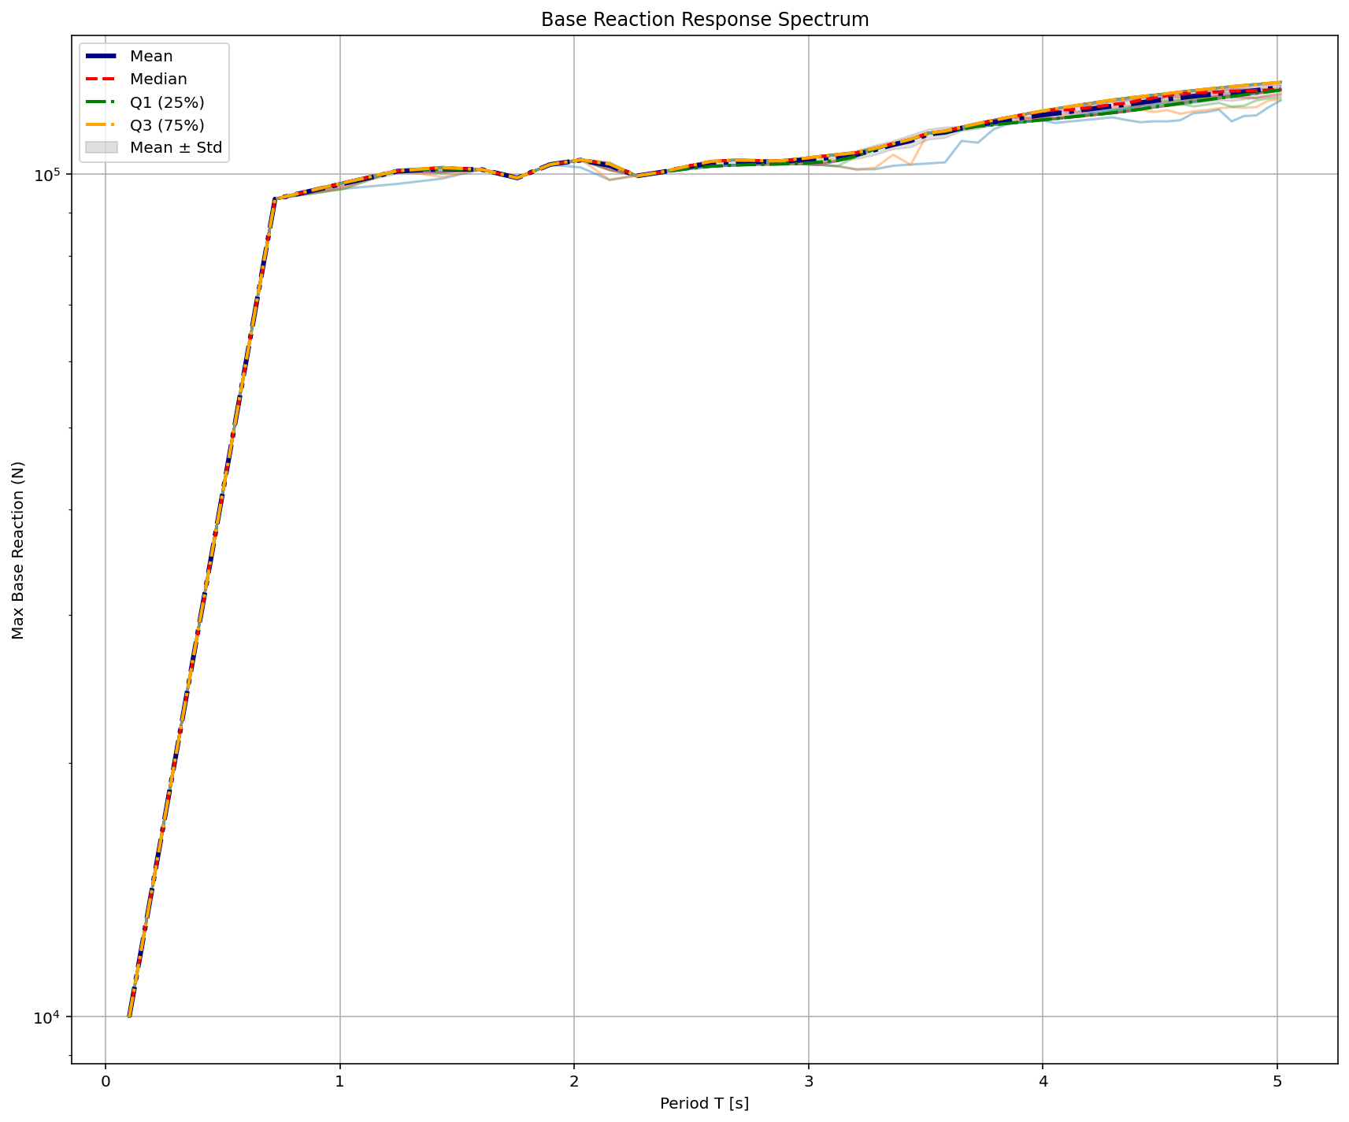

Slide 9
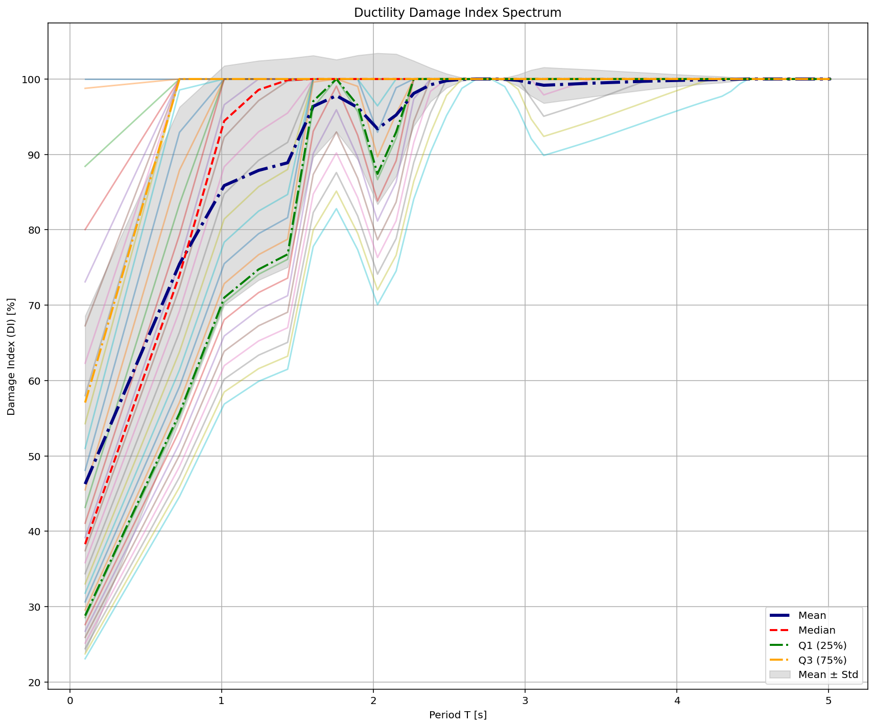

Slide 10
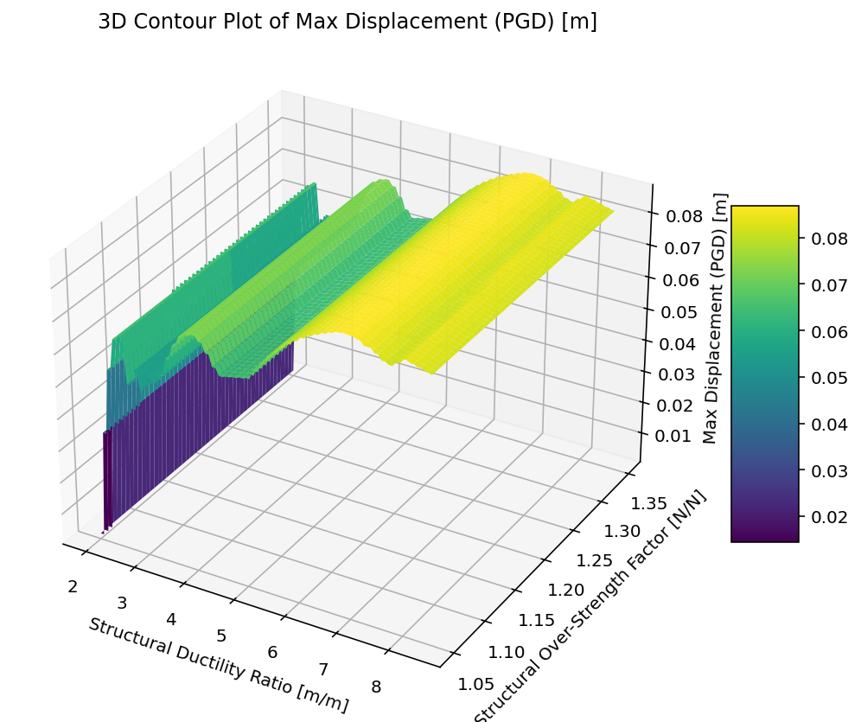

Slide 11
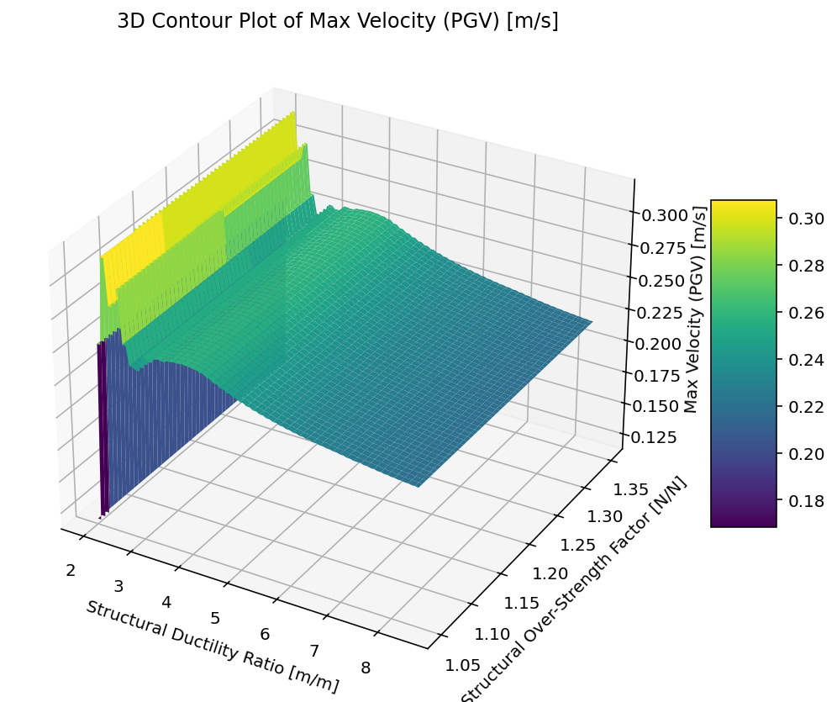

Slide 12
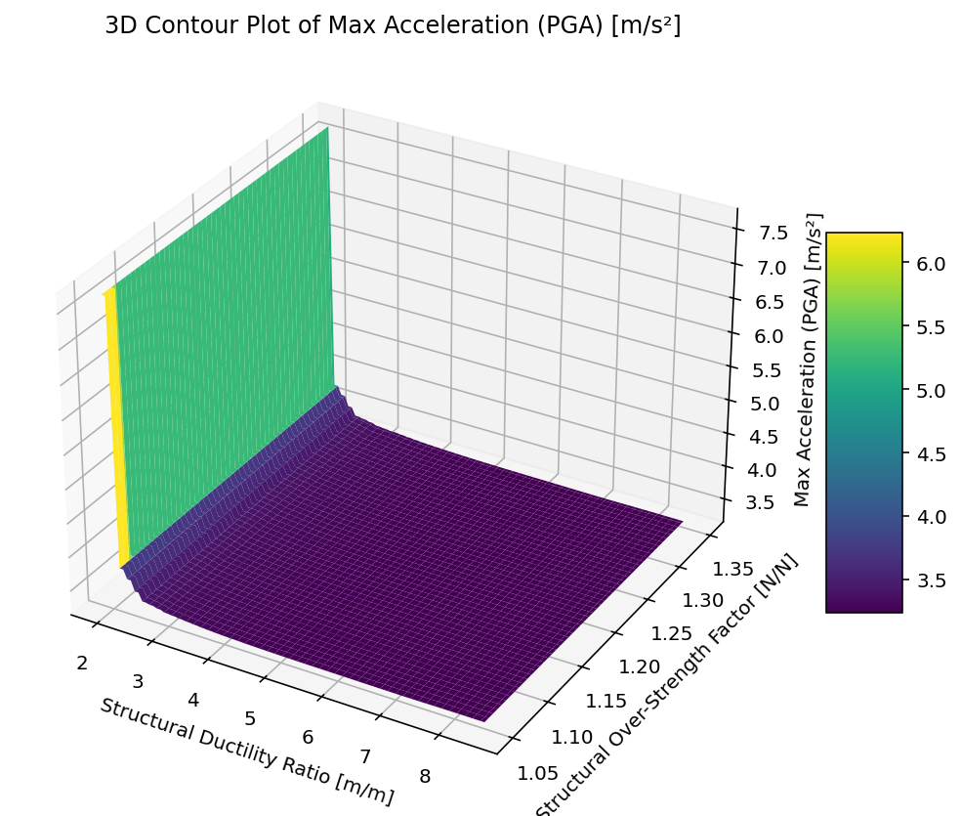

Slide 13
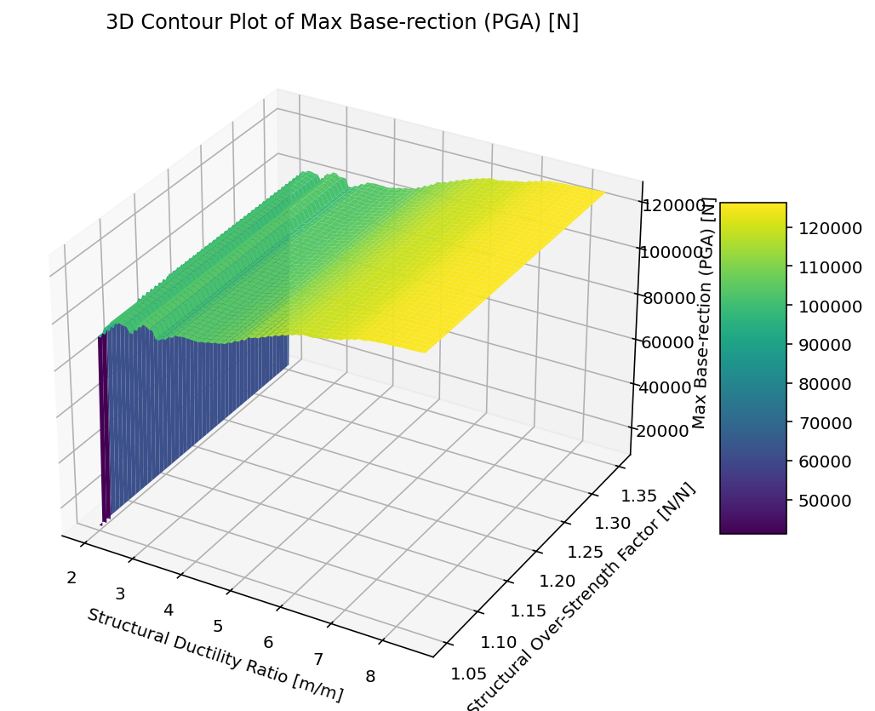

Slide 14
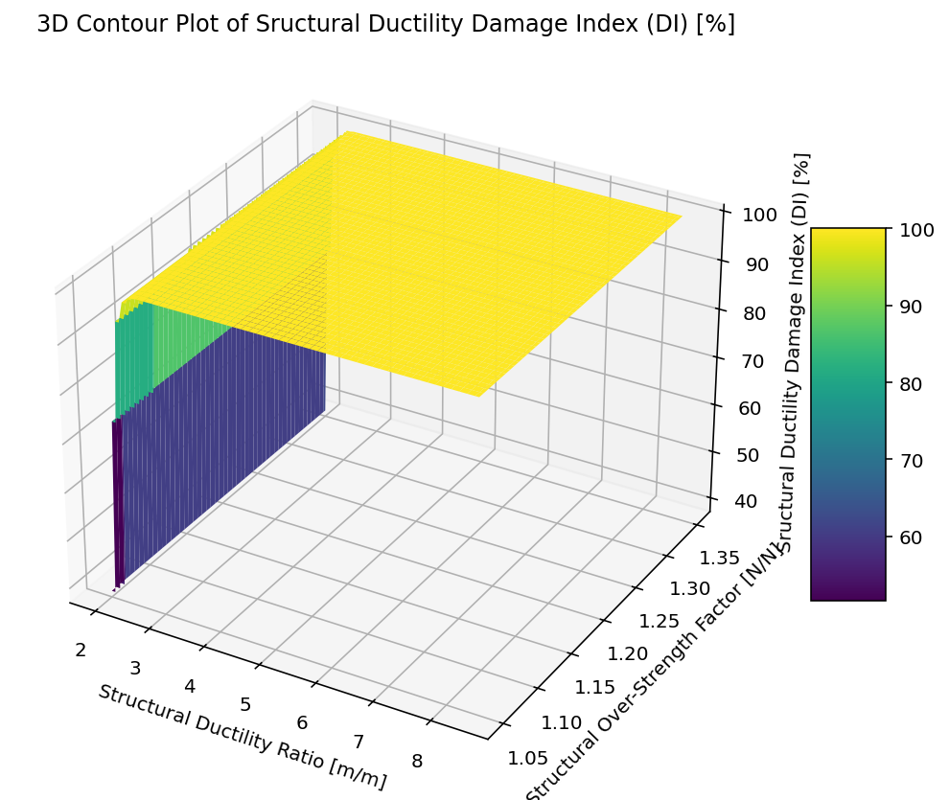

Slide 15
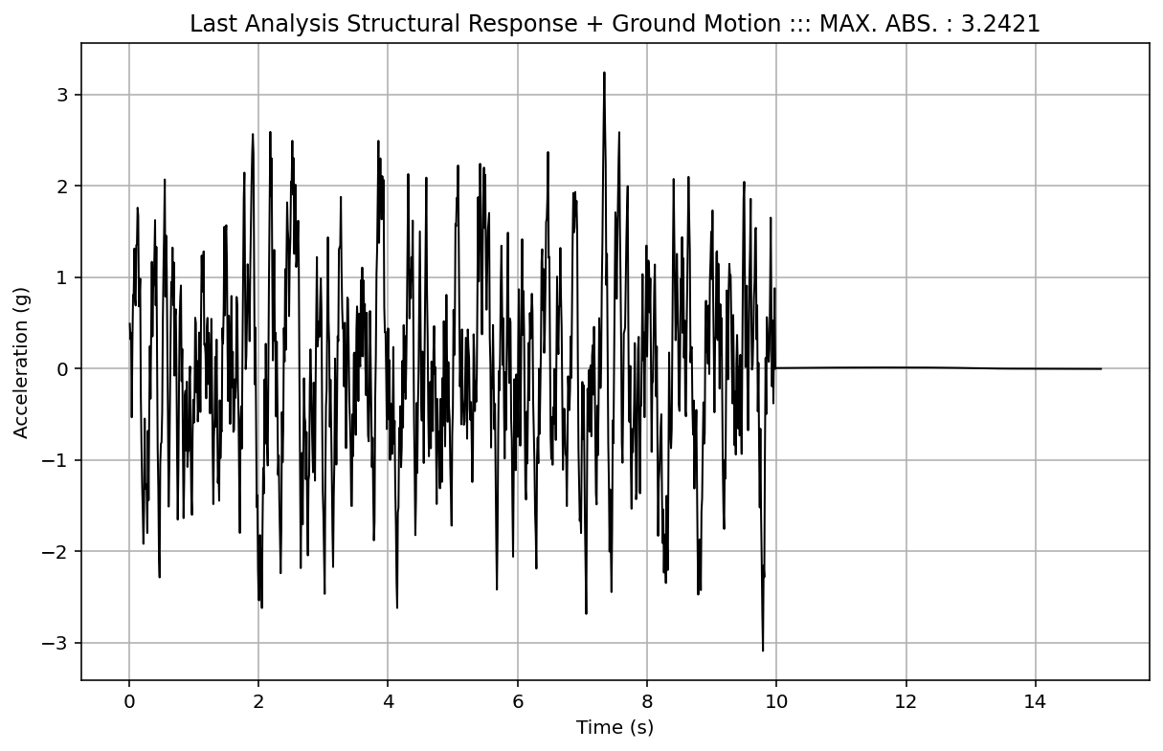

Slide 16
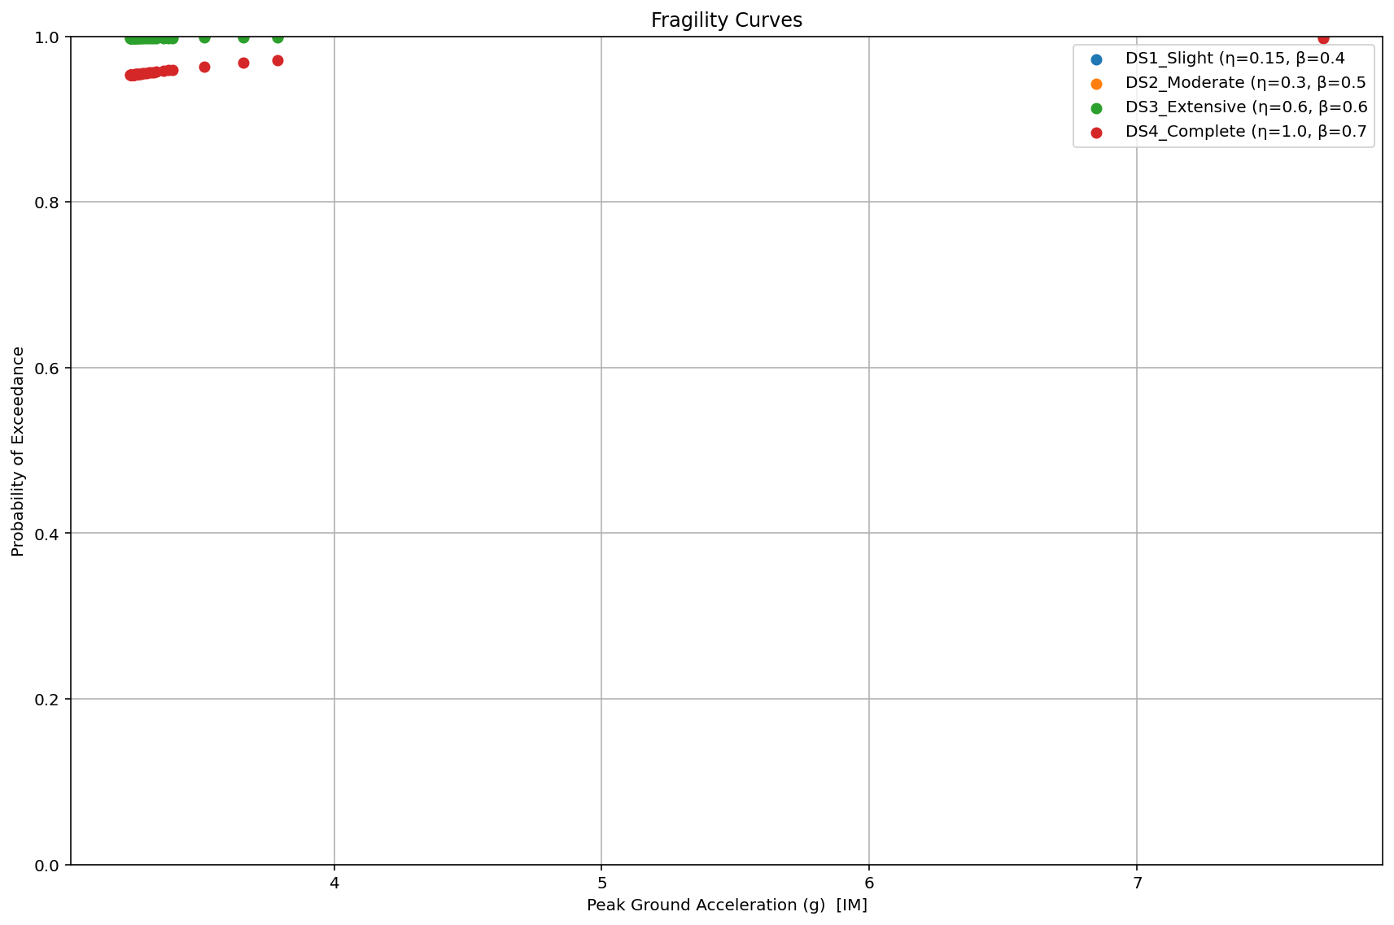

Slide 17
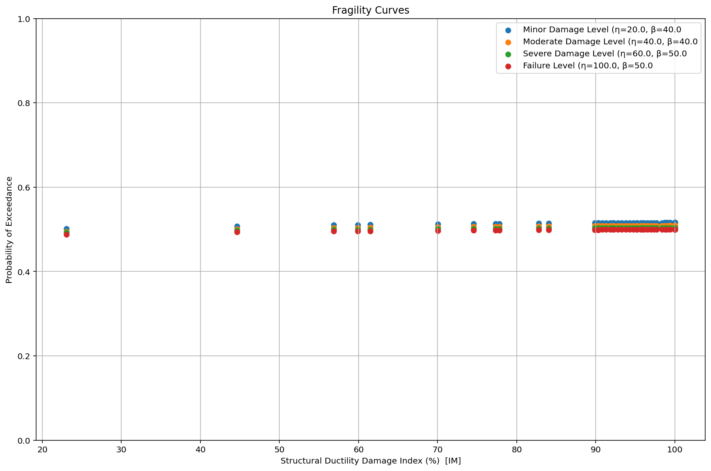

Slide 18
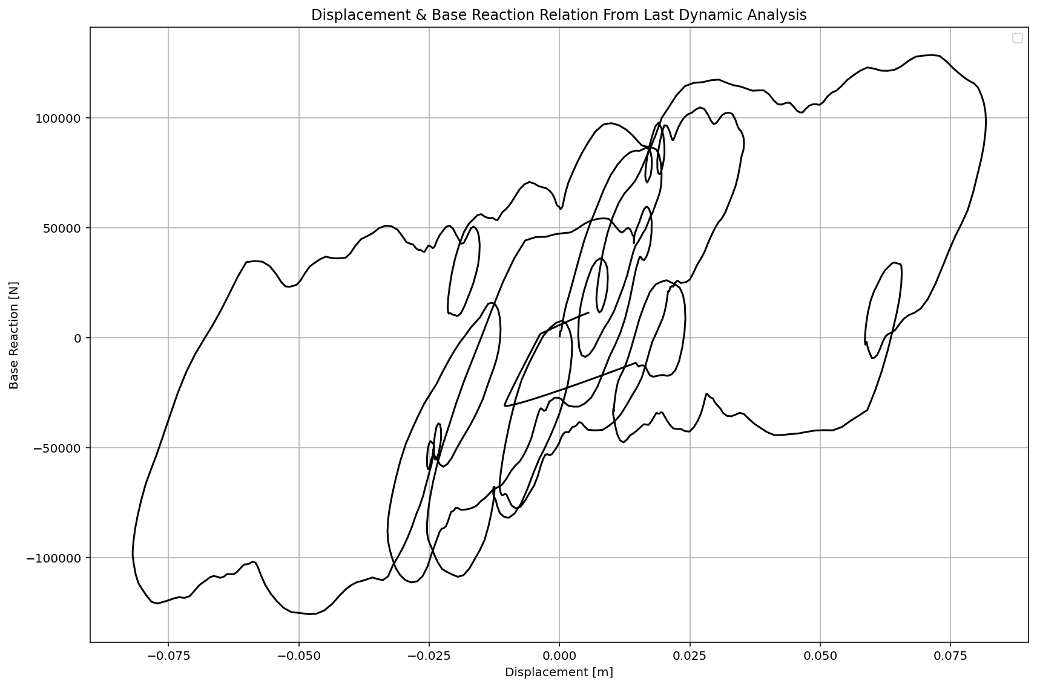

Slide 19
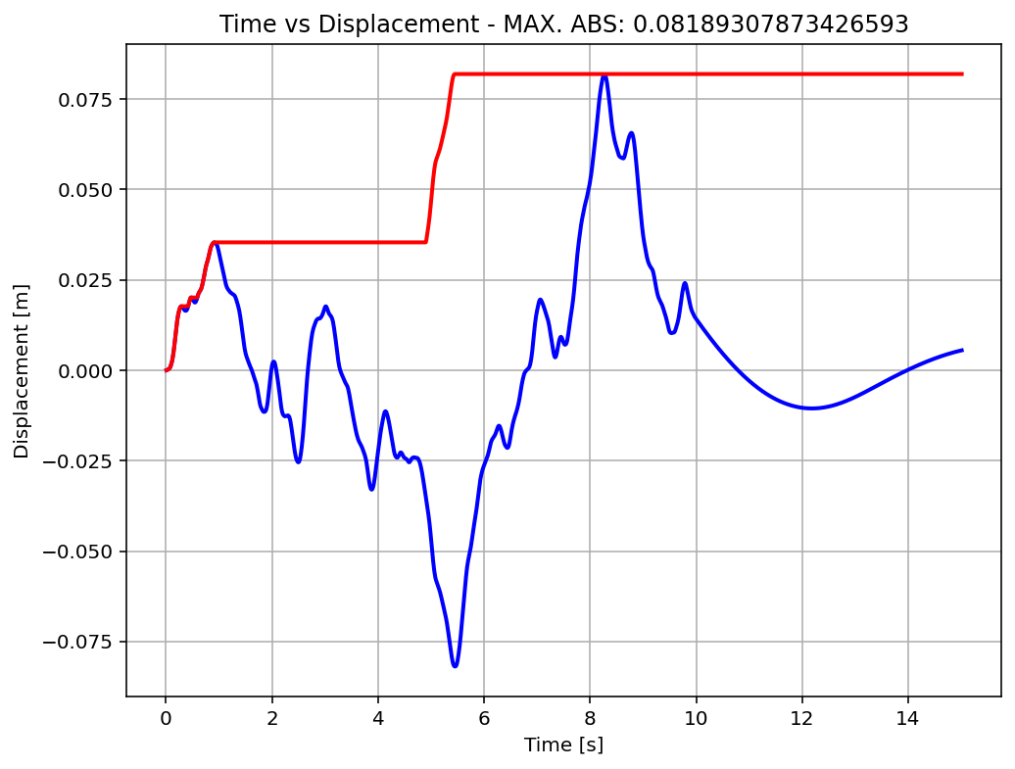

Slide 20
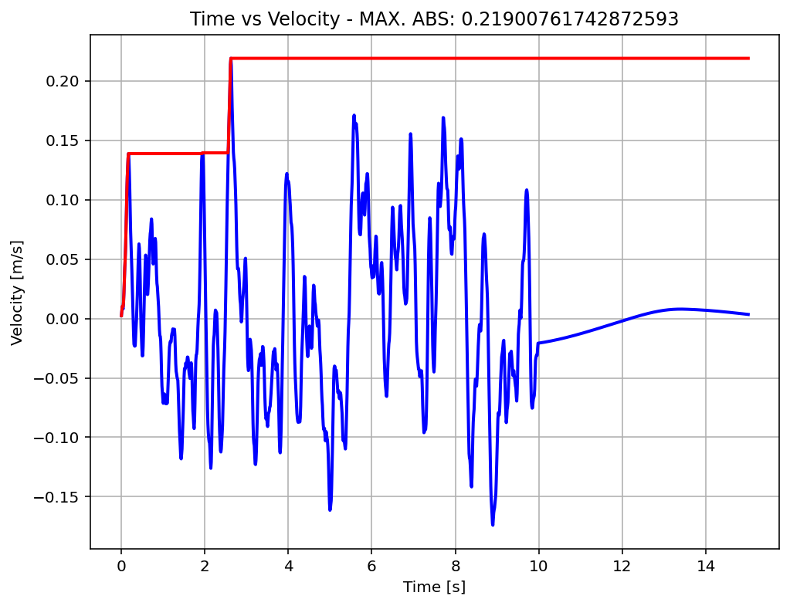

Slide 21
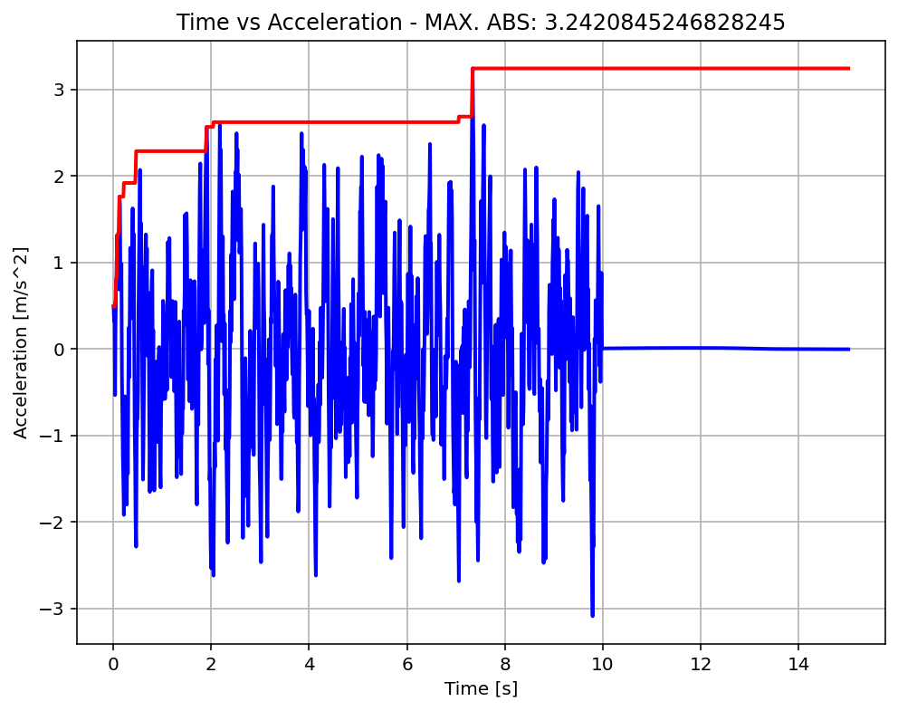

Slide 22
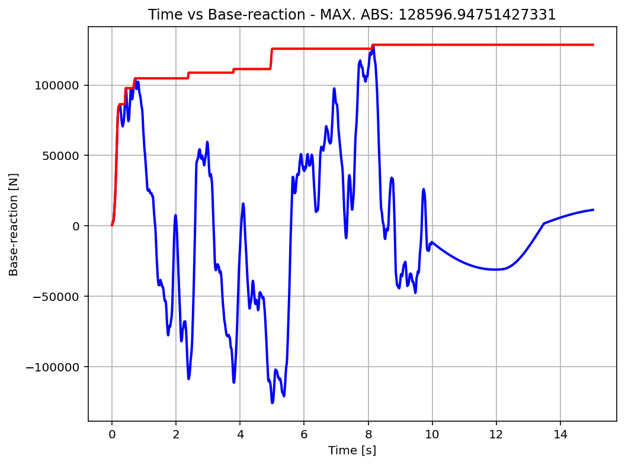

Slide 23
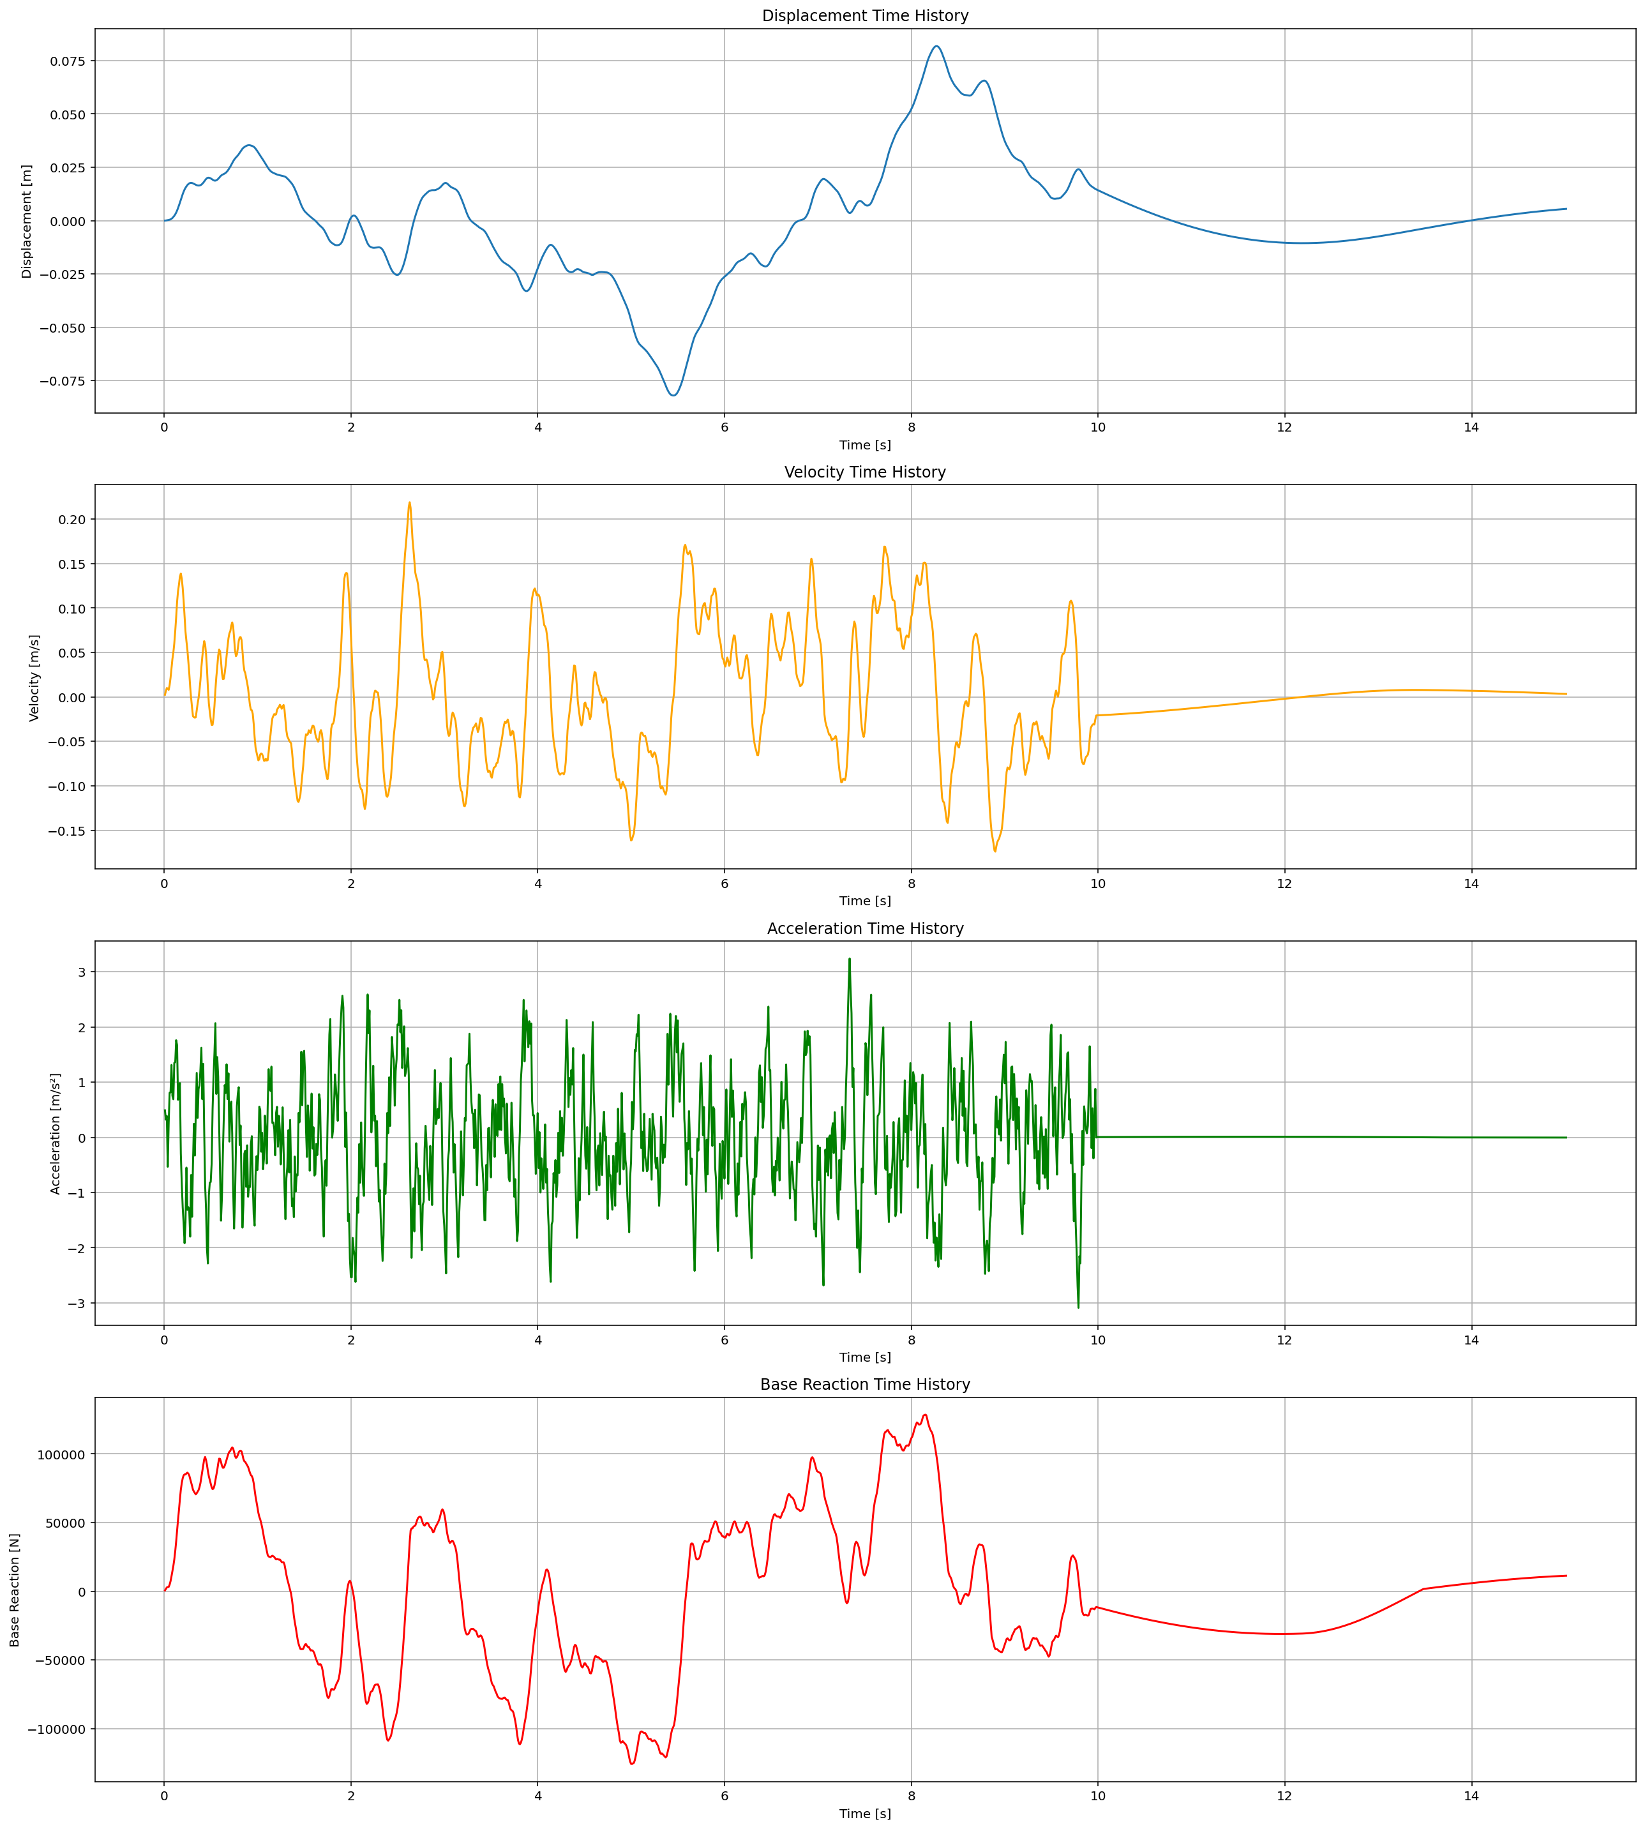

Slide 24
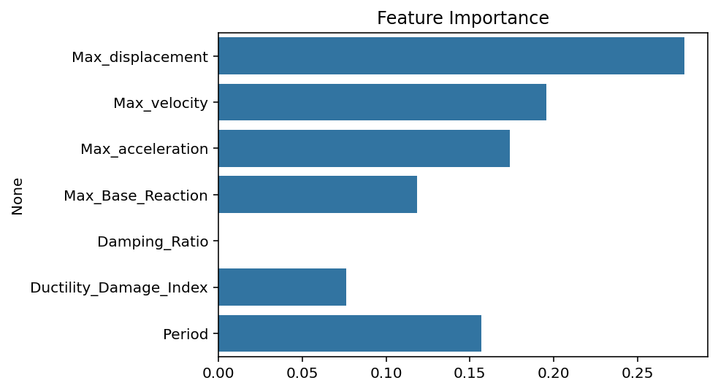

Slide 25
